Slide 1
Modular GWT
Clint Checketts – Jun 28 2012 @checketts

Slide 2

Clint Checketts
-mountain ninja, refactorer, programmer

Slide 3

Google Web Toolkit
Pronounced:
Gee Dub'l Yew Tea
vs.
Gwit
Gween!
Gweat gwandpa
Gwit!
Notes:
Ask about GWT experience-
Poll, gut reaction- Pirates versus ninjas?
Who are the Coders?
Written more than 100 lines of JS this year?
Know what JSON is?
What about Rest?

Slide 4
GWT- What is it?
It’s a toolkit, not a framework, library or ‘way’.
Notes:
Library- like tools, there are many, and it is easy to create your own
framework- frameworks like Wicket or Rails offer a end to end way of setting up your app with lifecycles and such
way- of doing things implies a set route and solution with minor customizability

Slide 5
GWT- What does it do?
Over simplification:
Compiles Java code into JavaScript

Slide 6
GWT- What is in it?
Compilation
Optimization
Widget
Layout
Event Handling beyond JavaScript
Client-Server communication
Simplified development and debugging
Integration with JavaScript
History
Internationalization (i18n)

Slide 7
GWT- What is in it?
Compilation
Optimization
Widget
Layout
Event Handling beyond JavaScript
Client-Server communication
Simplified development and debugging
Integration with JavaScript
History
Internationalization (i18n)

Slide 8

Follow Along with the Code
github.com/checketts/gwt-spring-demo

Slide 9
Minimal GWT App
Module
Entry Point
index.html, *.nocache.js

Slide 10
Minimal GWT App
Module
Entry Point
index.html, *.nocache.js

Slide 11
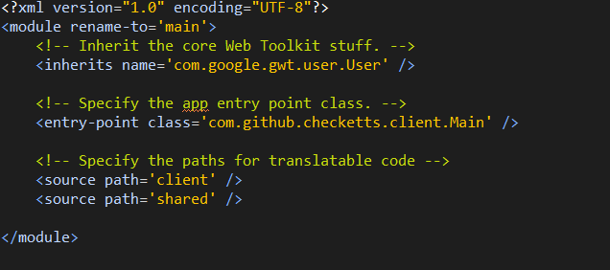
Minimal GWT App - Module

Slide 12
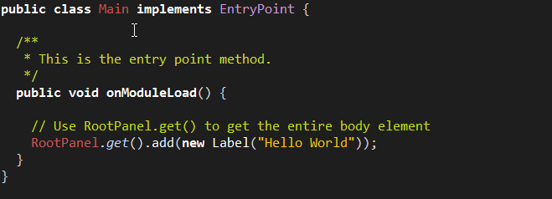
Minimal GWT App – Entry Point

Slide 13
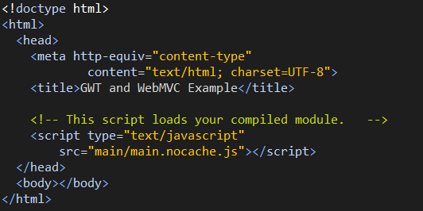
Minimal GWT App – index.html

Slide 14
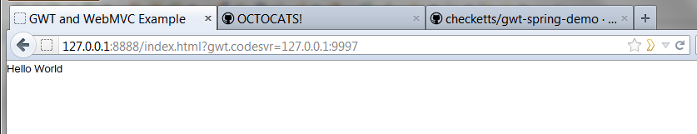
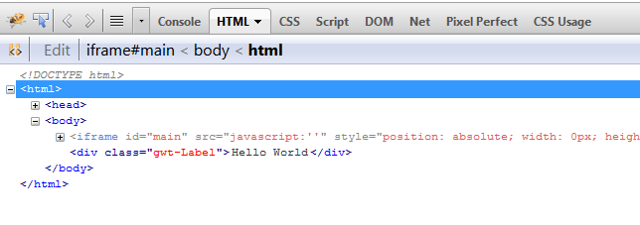
Minimal GWT App – Result

Slide 15
Why Java?
Excellent Tools
Static types
Well designed language
Clear scoping
Huge developer base

Slide 16
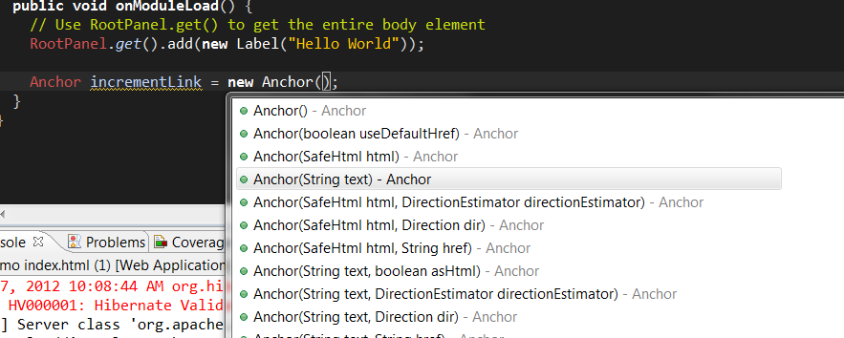
Java IDE
Notes:
Adding Widgets

Slide 17
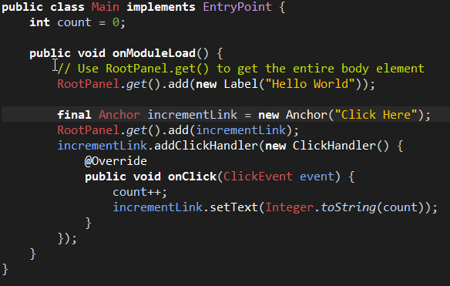
Adding Handlers

Slide 18
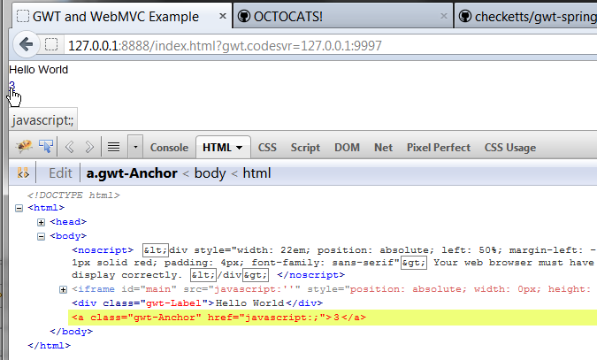
Results

Slide 19

Notes:
Warning about to run fast for newbies

Slide 20
Adding in the other pieces of GWT
CssResource
Code Splitting
Dependency Injection (Gin)
MVP
Widgets
Ui:binder
Tests

Slide 21
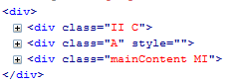
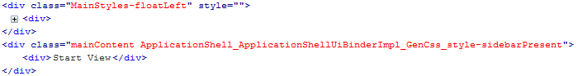
CssResource
Caching
Aggregation/Reuse
CSS class name constants
Deferred applying
Prevent rule clashes

Slide 22
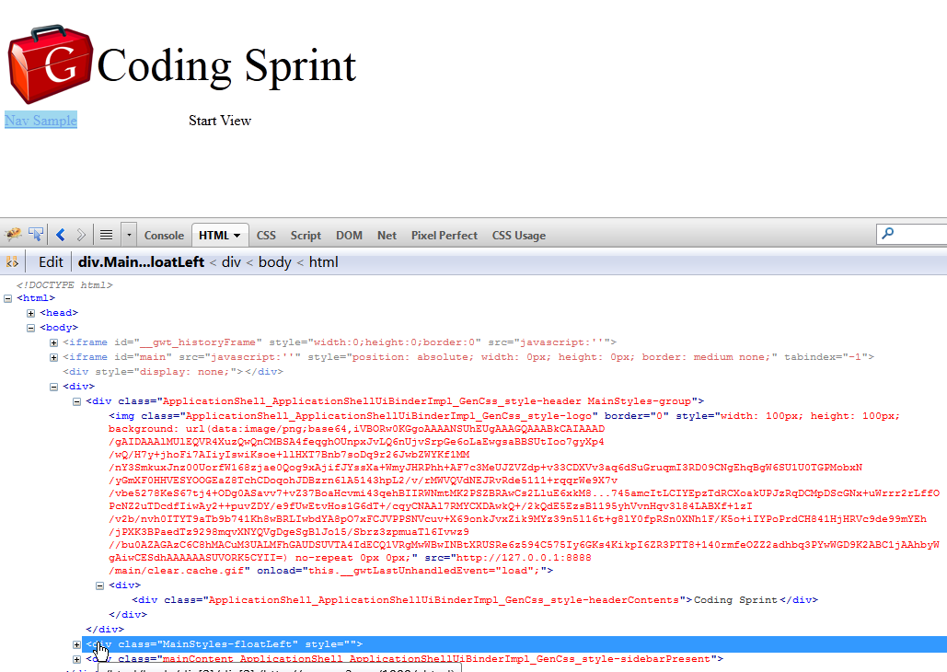
ImageResource
Data URIs
Base64 encoded images
Image Sprites
Several images combined

Slide 23
Code Splitting
Break the entire app into smaller pieces of JavaScript that can be fetched only when needed.
Notes:
Able to do this by looking at what code is used by a give ‘split point’

Slide 24
Dependency Injection
Code simplification
Best practice
Enables Testing
Code Splitting

Slide 25
MVP – Model View Presenter
Model
Presenter
View 1
View 1

Slide 26
MVP – Model View Presenter
Data
Place/
Activity
View 1
View 1

Slide 27
MVP
Place – url token/history
Activity – created based on place
Fetches model
Decides which view to display

Slide 28
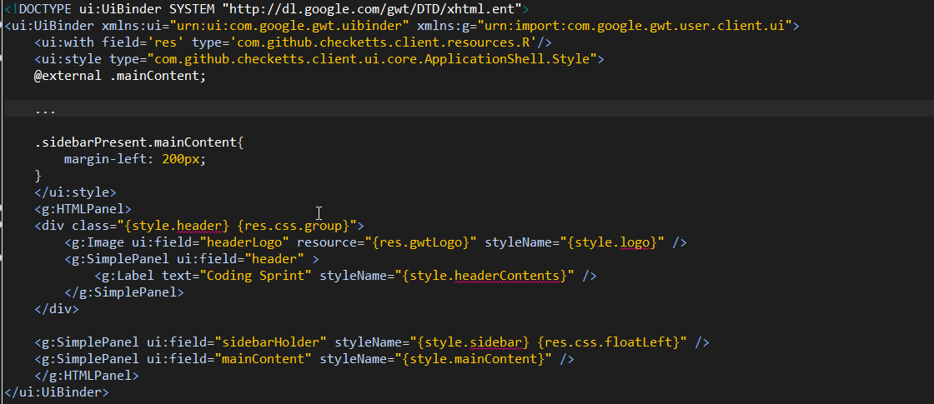
Widgets and ui:binder

Slide 29
Testing
JUnit
Pure Java code
Super fast
GwtTestCase
Unit test JavaScript/JSNI
Integration style test
Slower

Slide 30
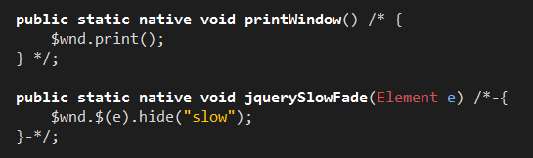
I can’t just drop JavaScript! - JSNI
JSNI (JavaScript Native Implementation)

Slide 31
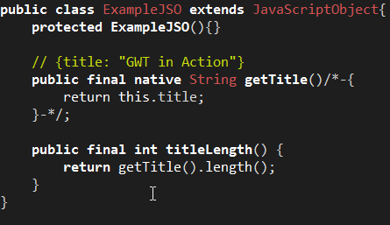
I can’t just drop JavaScript! - Overlays
JavaScript Overlays

Slide 32
Client – Server Communication
RequestBuilder
RPC*
AutoBeans
RequestFactory*
DataClutch
*Require using GWT specific servlets

Slide 33

Mullet Architecture

Slide 34
Modular Design
Phone
Key
Bluetooth
Locking Mechanism
Ignition
Ignition

Slide 35
Modular Design
Phone
Key
Bluetooth
Locking Mechanism
Ignition
Ignition
Loosely Coupled
Tightly Coupled

Slide 36
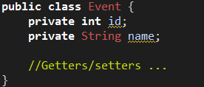
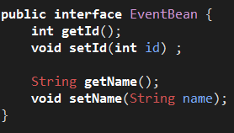
Keeping Client/Server separated
AutoBeans to the rescue!
Client JSON
(WebMVC)
AutoBeans
(DataClutch)
Java Pojos

Slide 37
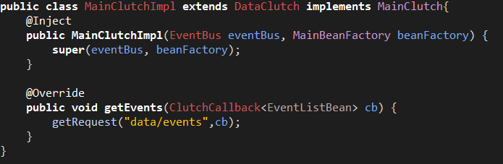
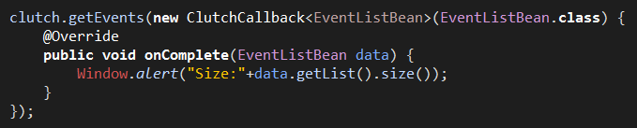
Using a Clutch
Subclassing DataClutch
Using a Clutch instance

Slide 38
Adding in the other pieces of GWT
CssResource
Code Splitting
Dependency Injection (Gin)
MVP
Widgets
Ui:binder
Tests

Slide 39
What about Dart?
Years away from completion
Lacks layout like ui:binder
No CssResource
No JSNI to quickly let you get to JS (or leverage native JS libraries like JQuery)
Dart2Js doesn’t create code split points
My take: watch it, it might be ready in 3 more years

Slide 40

Sources/Credit
GitHub Octocat- http://octodex.github.com
GWT In Action - http://www.manning.com/tacy/
Code- https://github.com/checketts/gwt-spring-demo

